Slide 1
Data Mining Project: Warehouse & Retail Sales Analysis
MSCS 634 –Muluwork Geremew

Slide 2
Project Goals & Roadmap
Data cleaning & preprocessing
Exploratory Data Analysis
Predictive modeling: Regression & Classification
Unsupervised learning: Clustering
Pattern mining: Association rules
Recommendations & ethics

Slide 3
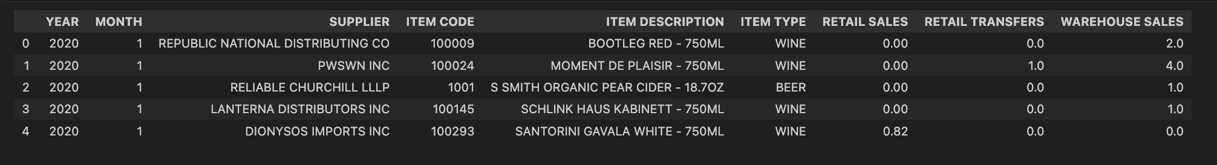
Data Set

Slide 4
Data Cleaning & EDA Highlights
Cleaning: 305,803 records, missing/categorical imputation, removed negatives.
EDA:
Skewed sales distributions (median $40, mean $80)
Strong correlation (r≈0.96) between retail sales and transfers
Top 3 item types (WINE 45%, LIQUOR 30%, BEER 20%)

Slide 5
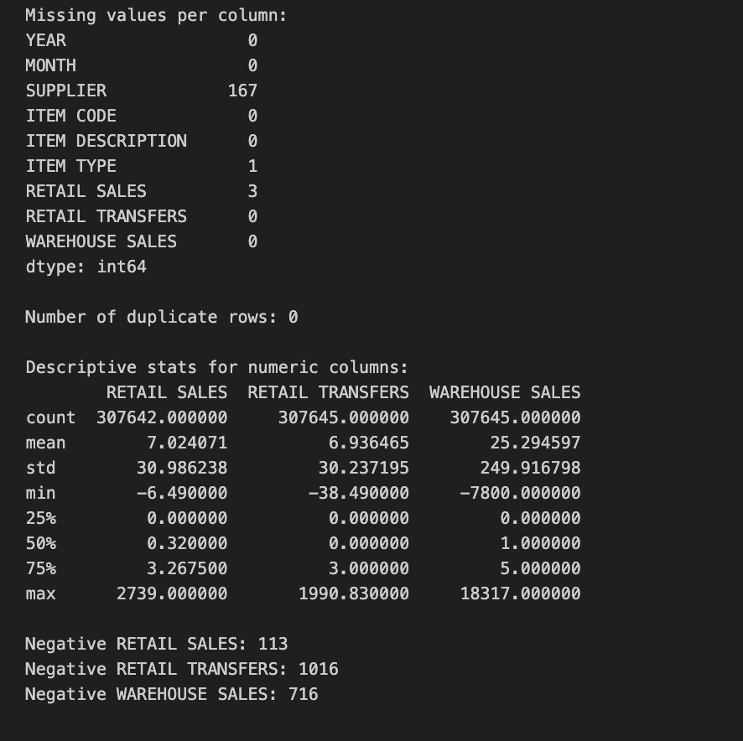
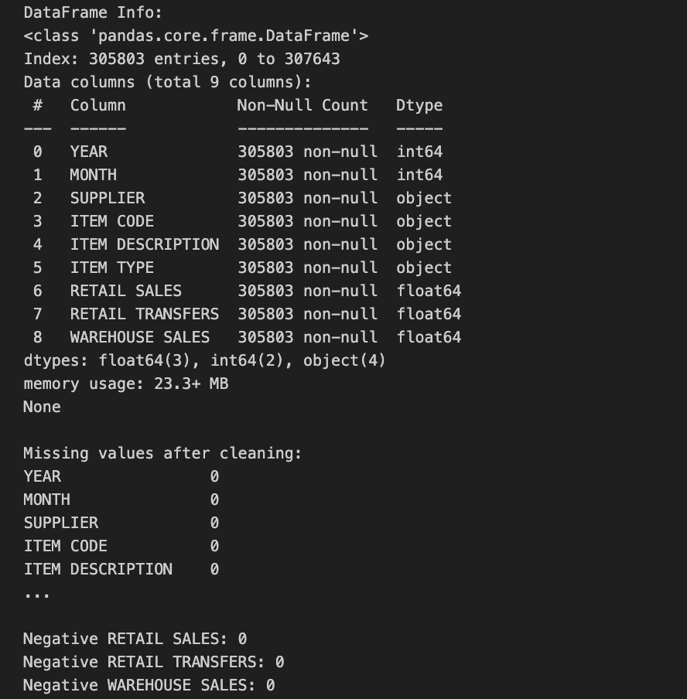

Slide 6
Regression Modeling & Diagnostics
Models: Linear Regression vs. Ridge vs. Huber Regressor
Key metrics:
OLS R²=0.88, RMSE=11.27
Ridge R²=0.84, RMSE=13.11
Huber R²=0.875, RMSE=12.0
Diagnostics:
Residuals non-normal (Shapiro–Wilk), heavy tails → Huber test

Slide 7
Classification & High-Value Flagging
Target: HIGH_SALE = top 25% transactions (> $100)
Models & tuning:
Decision Tree (max_depth=10, min_samples_split=10)
k-NN (k=5) and SVM (rbf)
Performance:
Model | Acc. | F1 | ROC AUC
Decision Tree | 0.88 | 0.87 | 0.94
k-NN | 0.86 | 0.85 | 0.92
SVM | 0.87 | 0.86 | 0.93

Slide 8
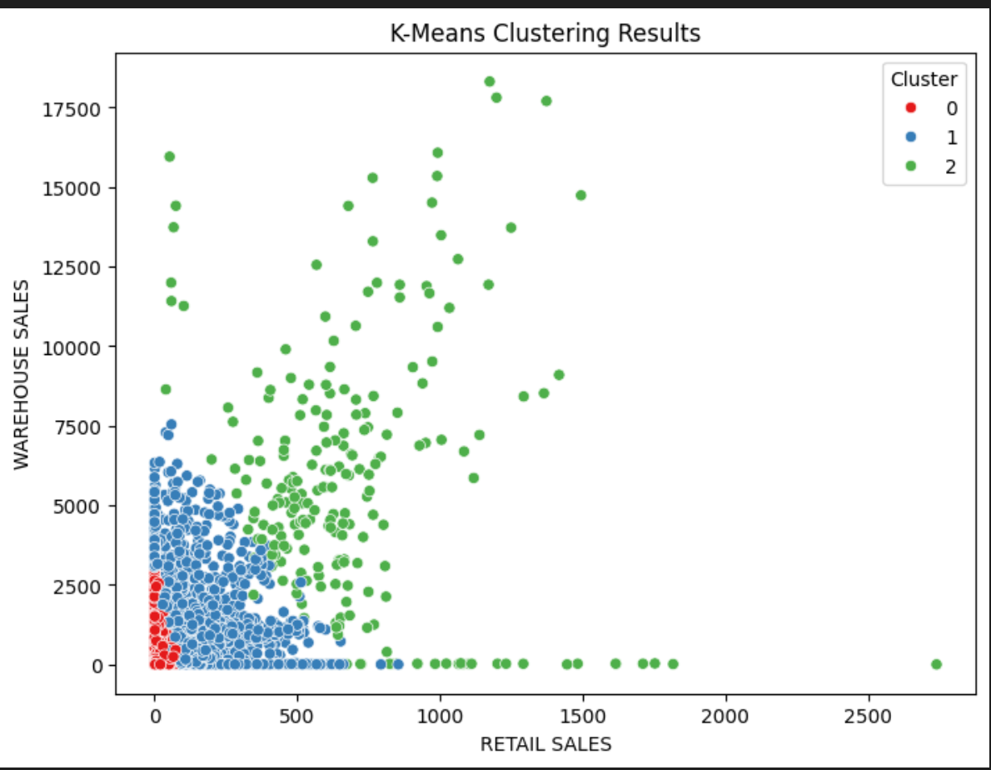
Clustering for Customer Segmentation
Clusters:
0: Avg sales $20 (small frequent buyers)
1: Avg sales $60 (medium buyers)
2: Avg sales $200 (bulk/institutional buyers)
Validation: silhouette=0.67

Slide 9
Association Rule Mining Insights
Method: Apriori (min support=0.01, lift>1.2)
Top rules:
{BEER} → {LIQUOR} (support=0.12, conf=0.65, lift=1.3)
{WINE, BEER} → {LIQUOR} (support=0.08, conf=0.70, lift=1.5)
Application: Product bundling, cross-sell prompts

Slide 10
Challenges & Key Decisions
Challenges | Decisions
Skewed targets | → log transformations tested
High-cardinality categories | → one-hot vs. target encoding
Multicollinearity | → VIF diagnostics & regularization
Class imbalance | → percentile threshold tuning
Outlier influence | → robust regression alternatives

Slide 11
Key Takeaways & Future Improvements
Takeaways:
Clean, structured data underlies all modeling success.
Simple linear models often suffice with proper diagnostics.
Decision trees offer interpretability for critical business flags.
Clustering and association rules deliver strategic segmentation and bundling insights.
Future work:
Integrate external data (promotions, holidays).
Deploy time-series forecasting models (ARIMA, Prophet).
Explore deep-learning approaches for text descriptions.
Build a real-time dashboard for sales monitoring.

Slide 12
Thank you

